Slide 1
Car Performance Prediction Using Machine Learning Techniques on IBM Watson Studio
Presented by:
Team no: CSE-16
19UK1A05B2- SAHITHI VAVILALA
19UK1A05E0- MOUNIKA SANGINENI
19UK1A05D8- MANIDEEP MARKA
19UK1A05B4- CH SAVANTH
19UK1A05C4- SURYA BANDLOJU

Slide 2
OUTLINE
INTRODUCTION
OBJECTIVE
DATA
MACHINE LEARNING APPROACHES
VISUALIZATION OF GRAPHS
IBM WATSON STUDIO
SOFTWARE REQUIREMENTS
CONCLUSION

Slide 3
INTRODUCTION
Overview
Predicting the performance level of automobiles is a challenging and fascinating topic. The major purpose is to predict the car's performance in order to optimize the vehicle's specific behaviour. This can considerably reduce fuel usage and increase efficiency in the system. The car's performance is evaluated based on the engine type, number of cylinders, fuel type, and horsepower, among other factors. These are the variables that can be used to forecast the car's health. It is a continuous process of gathering, studying, analyzing, and documenting information about one's health based on the three variables listed above. Mileage, dependability, flexibility, and affordability are all performance objectives that can be paired together to help the prediction engine and engine management system. This method is critical for fully comprehending the vehicle's performance.
Purpose
Prior to the last decade, cars were constructed for high-speed operation, comfort, and safety due to a surplus of gasoline. As the scarcity of fuel grows due to the excessive use of fuel in automobiles, numerous researchers have begun to study alternative fuels, car body redesign, and aerodynamic loss reduction. To compensate for these losses, spoilers are employed, necessitating the optimization of its shape. This research is primarily focused on determining the optimal design of a car spoiler in order to reduce mass and hence fuel consumption while maintaining aerodynamic qualities and strength. The results of a Computational Fluid Dynamics (CFD) analysis of a two-dimensional model of a spoiler are validated by previous research in this field for understanding changes in aerodynamic property of cross-section. The results of the three-dimensional CFD analysis of the spoiler provide aerodynamic properties and pressure data that can be used to compare the results of the optimized model generated by the optimized cross-sectional shape. The Shape Optimization tool in ANSYS 14.0 is used to optimize the shape, which is then tested for design failure in ABAQUS. 2.LITERATURE SURVEY [1] Artificial Neural Network (ANN) model was used to help cars dealers recognize the man

Slide 4
OBJECTIVE
By the end of this project:
You’ll be able to understand the problem to classify if it is a regression or a classification kind of problem.
You will be able to know how to pre-process/clean the data using different data preprocessing techniques.
You will able to analyze or get insights into data through visualization.
Applying different algorithms according to the dataset and based on visualization.
You will be able to know how to build a web application using the Flask framework.

Slide 5
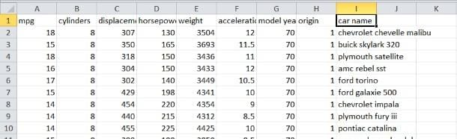
DATA
Car Performance Dataset for predicting the performance of a car.
399 rows with 9 columns
mpg,
cylinders,
displacement,
horsepower,
weight,
acceleration,
model year ,
origin,
car name

Slide 6
DATA VISUALISATION:
Data visualization is where a given dataset is presented in a graphical format. It helps the detection of patterns, trends and correlations that might go undetected in text-based data. Understanding your data and the relationship present within it is just as important as any algorithm used to train your machine learning model. Machine learning models will perform poorly on data that wasn’t visualized and understood properly.
To visualize the dataset we need libraries called Matplotlib and Seaborn. The Matplotlib library is a Python 2D plotting library that allows you to generate plots, scatter plots, histograms, bar charts etc.

Slide 7
MODEL BUILDING
There are several Machine learning algorithms to be used depending on the data you are going to process such as images, sound, text, and numerical values. The algorithms that you can choose according to the objective that you might have it may be Classification algorithms or Regression algorithms.
Example:
1.Linear Regression
2.Logistic Regression
3. Random Forest Regression / Classification.
4. Decision Tree Regression / Classification.
You will need to train the datasets to run smoothly and see an incremental improvement in the prediction rate.
On our Dataset , we have applied Linear Regression and Random Forest Regression to predict the Accuracy.

Slide 8
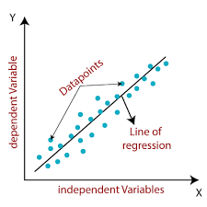
MACHINE LEARNING ALGORITMS
Linear Regression:
Linear Regression is a supervised machine learning algorithm where the predicted output is continuous and has a constant slope. It's used to predict values within a continuous range, (e.g. sales, price) rather than trying to classify them into categories (e.g. cat, dog).
Steps to implement Linear regression model:
Initialize the parameters.
Predict the value of a dependent variable by given an independent variable.
Calculate the error in prediction for all data points.
Calculate partial derivative w.r.t a0 and a1.
Calculate the cost for each number and add them.

Slide 9
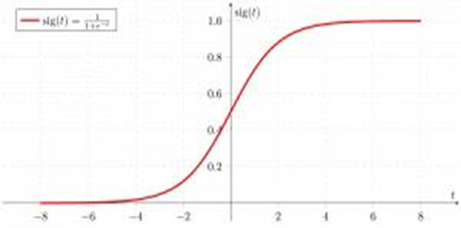
Multiple Linear Regression
Multiple Linear Regression is one of the important regression algorithms which models the linear relationship between a single dependent continuous variable and more than one independent variable.
Random Forest
A random forest is a machine learning technique that’s used to solve regression and classification problems. It utilizes ensemble learning, which is a technique that combines many classifiers to provide solutions to complex problems.
Working of Random Forest Algorithm
Step 1 − First, start with the selection of random samples from a given dataset.
Step 2 − Next, this algorithm will construct a decision tree for every sample. Then it will get the prediction result...
Step 3 − In this step, voting will be performed for every predicted result.
Step 4 − At last, select the most voted prediction result as the final prediction result.

Slide 10
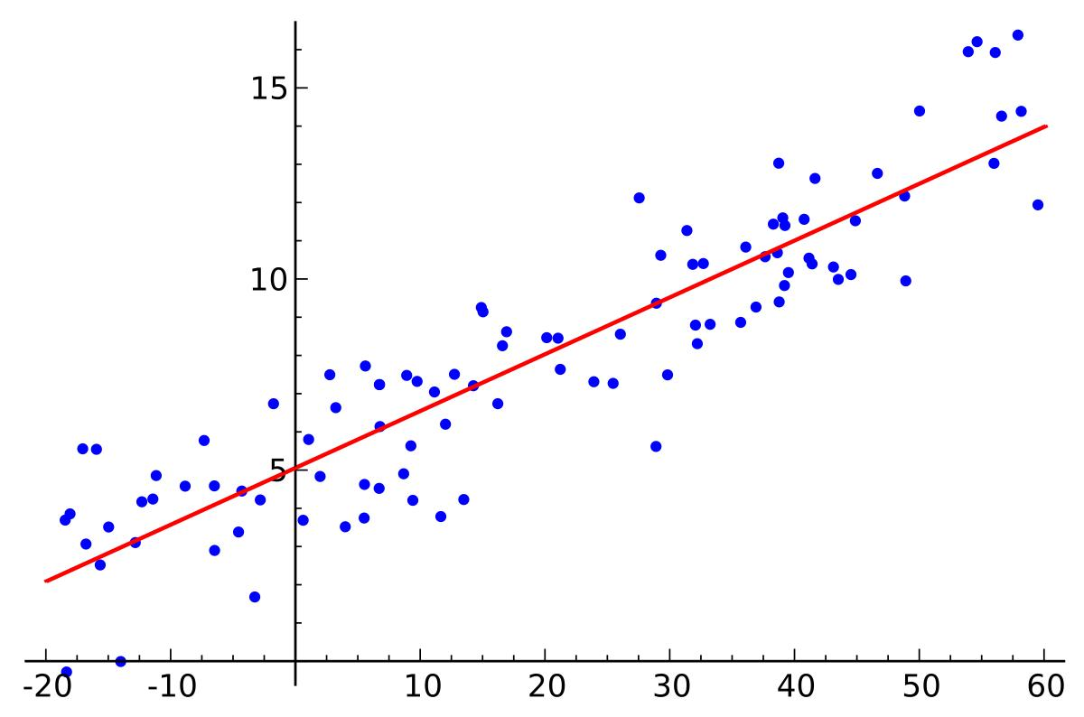
LOGISTIC REGRESSION:
Logistic regression is a supervised learning classification algorithm used to predict the probability of a target variable. The nature of target or dependent variable is dichotomous, which means there would be only two possible classes. ... Mathematically, a logistic regression model predicts P(Y=1) as a function of X.
Logistic Regression is used when the dependent variable (target) is categorical. For example,
To predict whether an email is a spam (1) or (0)
Whether the tumor is malignant (1) or not (0)

Slide 11
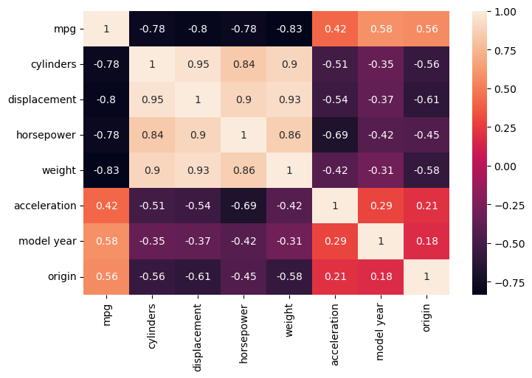
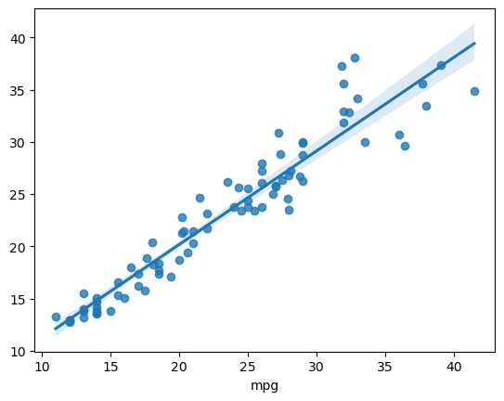
VISUALISATION OF GRAPHS
Heatmap: it is way of representing the data in 2-D form. It gives coloured visual summary of data
sns.regplot

Slide 12
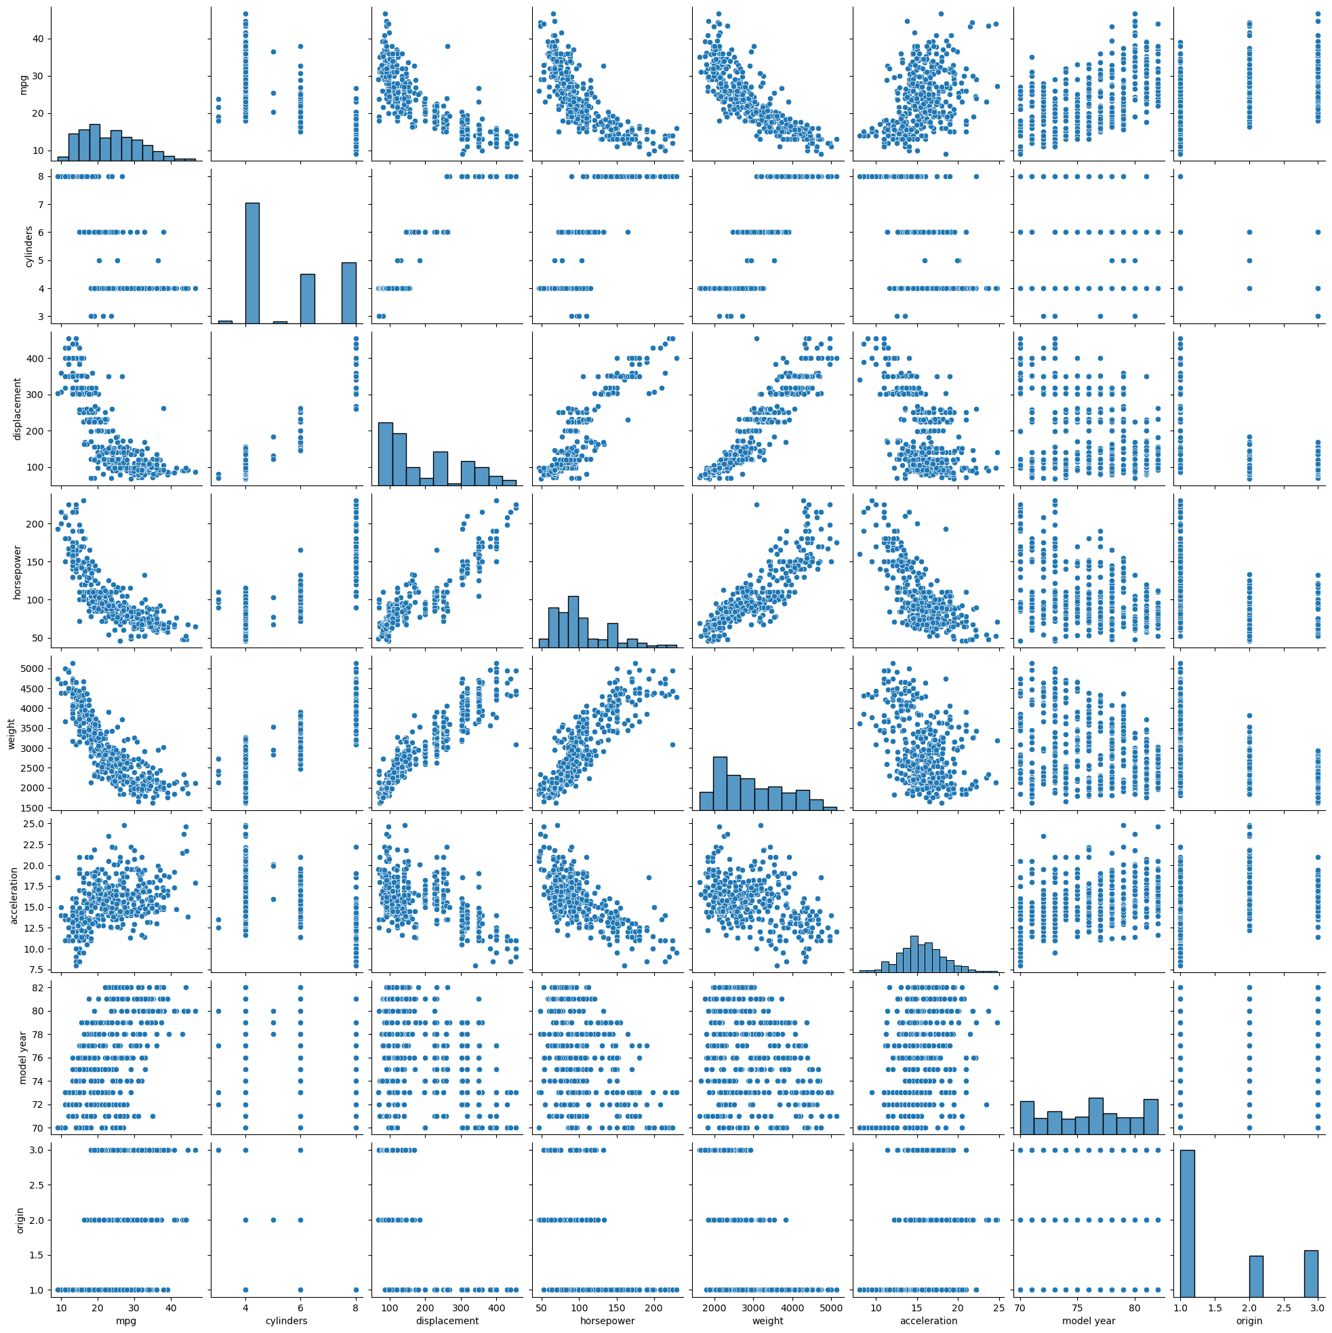
Pair plot usually gives pair wise relationships of the columns in the dataset From the above pair plot we infer
mpg,
cylinders,
displacement,
horsepower,
weight,
acceleration,
model year ,
origin,
car name

Slide 13
IBM WATSON STUDIO
IBM Acquired soft layer, a public cloud platform, to serve as the foundation for its IaaS offering. In October 2016, IBM rolled the soft layer brand under its Blue mix brand of PaaS offerings, giving users to access both IaaS and PaaS resources from a single console. IBM cloud provides a full-stack, public cloud platform with various products in the catalog, including options for compute, storage, networking, end to end developer solutions for app development, testing and deployment, security databases, and cloud native services.
We Created the IBM cloud account by going to the IBM cloud login page. Then we login to IBM Watson Studio and deployed our model on IBM.
Advantages of deploying model on CLOUD:
Security and privacy. Much like a private cloud, you can ensure your data remains secure when you are the only organization that uses the private portion of your infrastructure.
Potential cost savings.
Superior flexibility and scalability.

Slide 14
SOFTWARE REQUIREMENTS
Anaconda navigator
Jupyter notebook
Machine learning tools: pandas,
numpy,
matplotlib,
scikitlearn,
seaborn
IBM Watson Studio

Slide 15
CONCLUSION
In this project we have predicted the car performance level on the basis of engine type, horsepower, no.of engines, cylinders, fuel type etc.
Prediction is done using Machine Learning Techniques.
For the better results we used Linear regression algorithm, Random Forest algorithm and proved with 99% accuracy.

